Slide 1
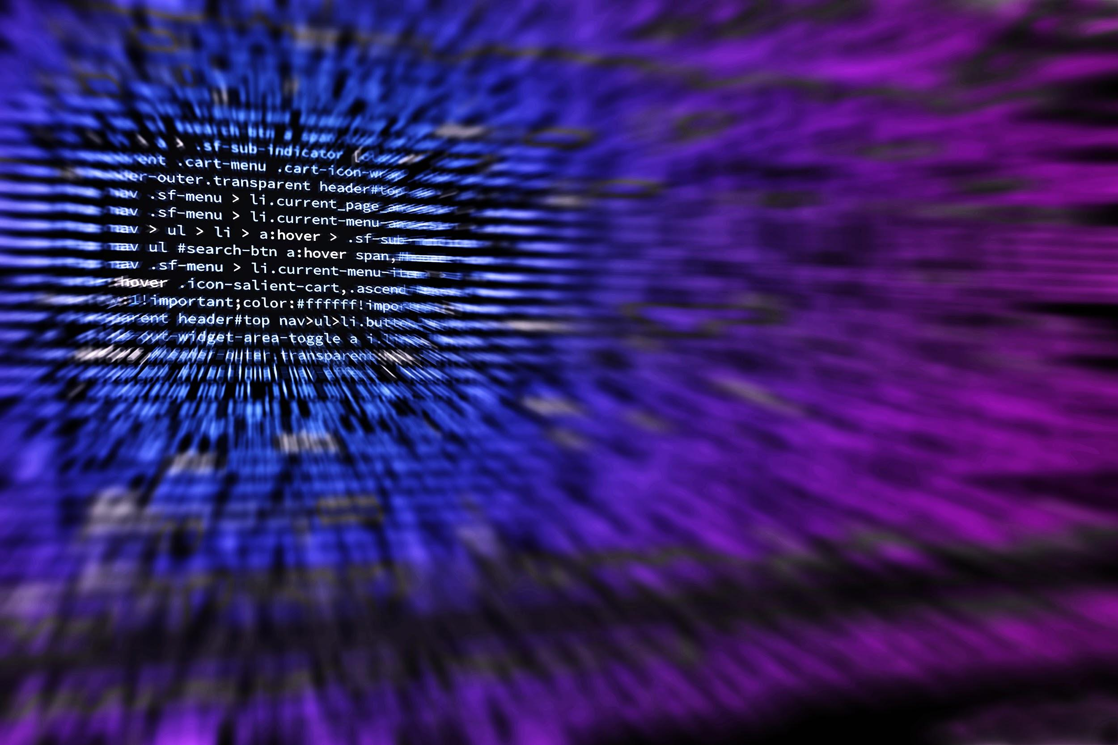
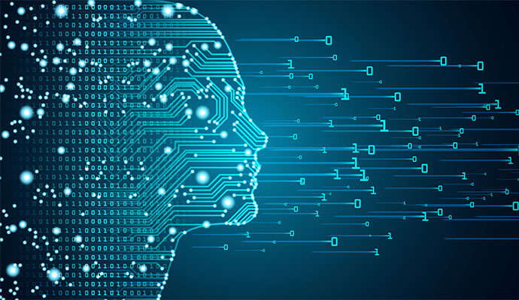
Machine learning on the Edge
How to take advantage of the ML in the Edge devices
Jawahar M, Product Manager, Nokia

Slide 2

Agenda
Machine learning basics
ML on Edge devices
Roles in the ML
Introduction to Machine learning
Types of Machine Learning
Need for ML on edge
Edge devices
Real time use case
Different Roles
Resources to look out
Notes:
TimeAgenda Things to be covered in this session

Slide 3
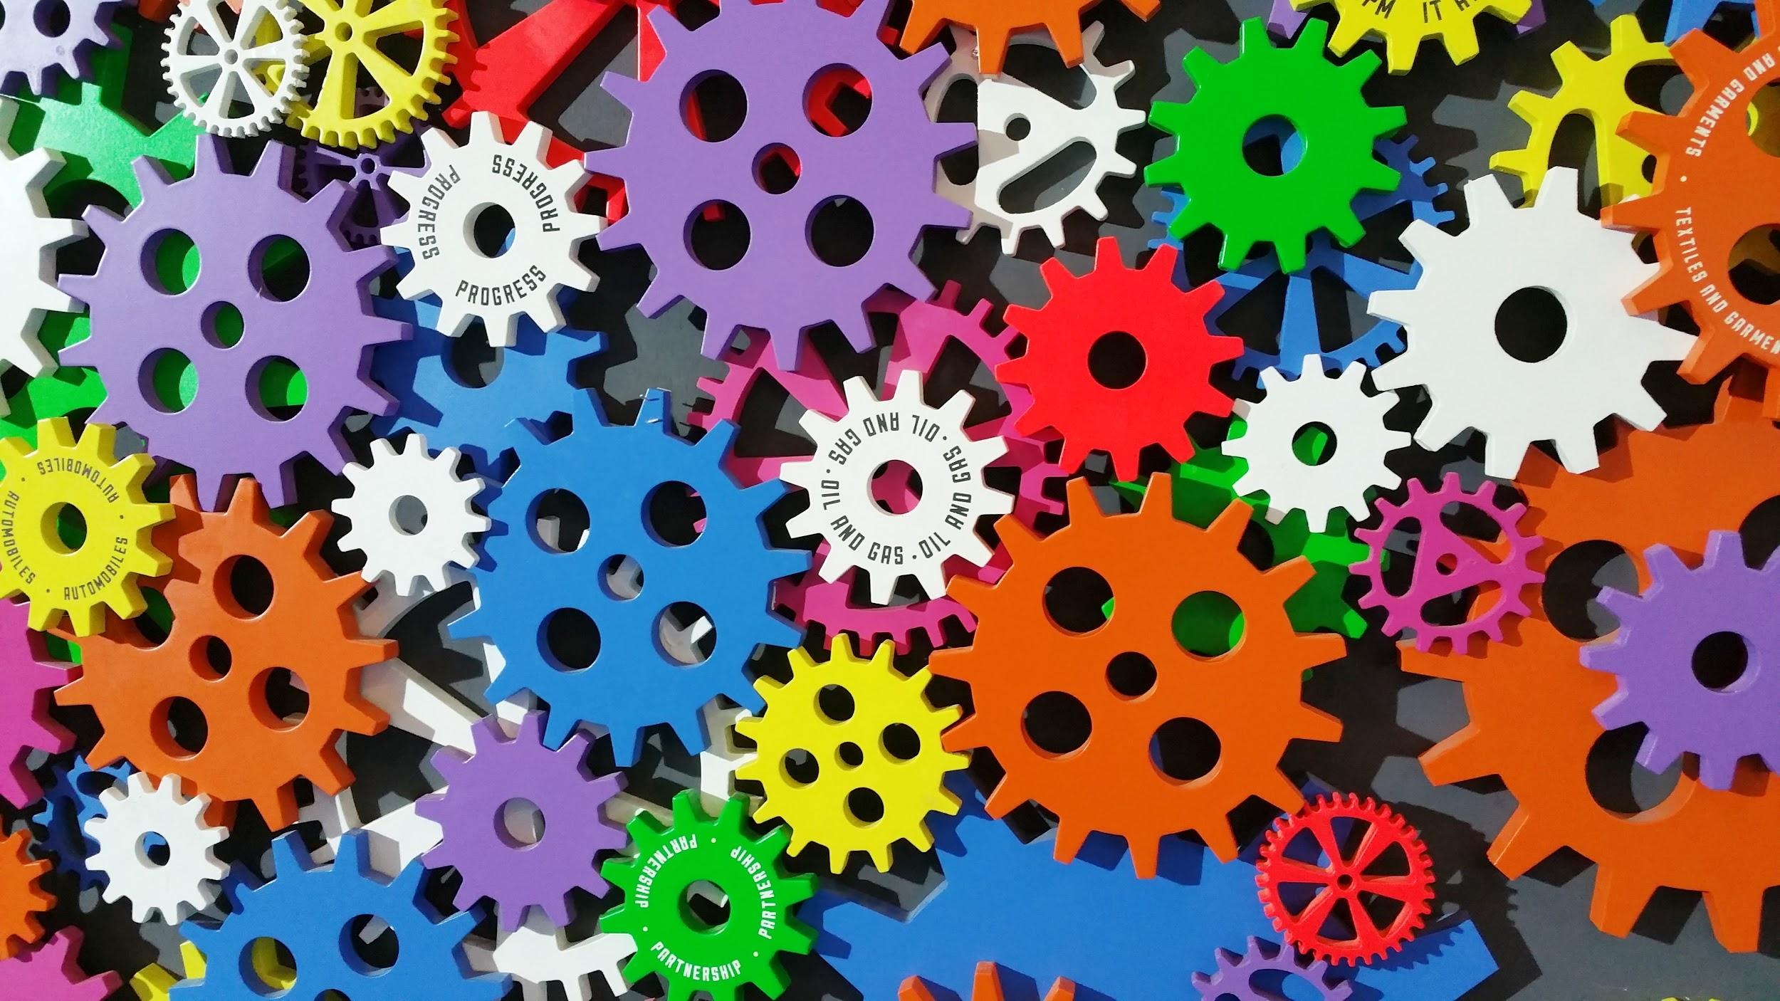
What is machine learning?

Slide 4

source: https://xkcd.com/1838/
Notes:
source: https://xkcd.com/1838/

Slide 5

One such definition
"Machine learning is the semi-automated extraction of knowledge from data"
Notes:
Knowledge from data: Starts with a question that might be answerable using data
Automated extraction: A computer provides the insight
Semi-automated: Requires many smart decisions by a human

Slide 6
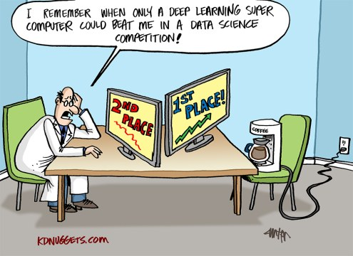

Slide 7

Categories
Supervised Learning
Predictions using data
Example: Is a given email "spam" or "ham"?
UnSupervised
Extracting structure from data
Segment grocery store shoppers
Semi Supervised
combination of labelled training data and unlabeled data
Reinforcement
modifies internal models based on the outcome of a series of tests
Network Control Algorithms

Slide 8
Where Does Machine Learning Fit?
Stages of Knowledge Acquisition
Data Analytics are the process and methods we use to augment our experience of the information hidden in large data sets
Increasing Proficiency
Autonomy
Machine Learning algorithms create “knowledge” (or proficiency) using a process similar to the process people use to acquire knowledge
Machine Learning: Learning Systems
Knowledge
The Knowledge Acquisition Process
Machine Learning: Learning Units
Re-Conjecture
Information
Test
Machine Learning
automates this
part of the process
Data Analytics
Analytics
automates
this part of
the process
Learning
Information
Data
Analysis & Viz
Increasing Sophistication of AI Technologies
Data
Conjecture

Slide 9
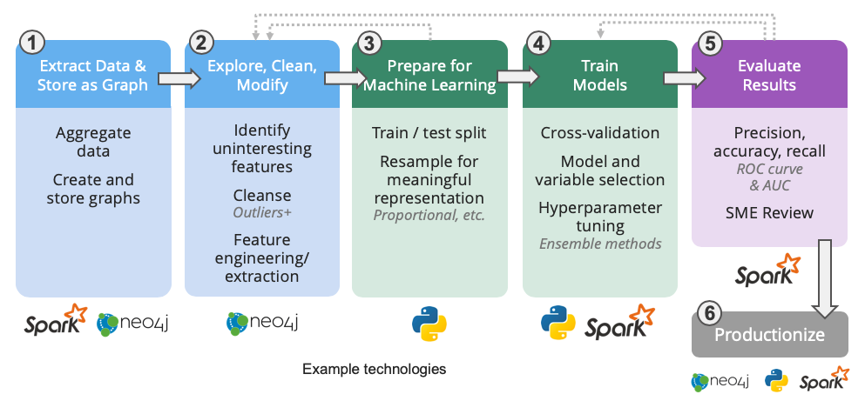
Workflow of Machine Learning

Slide 10
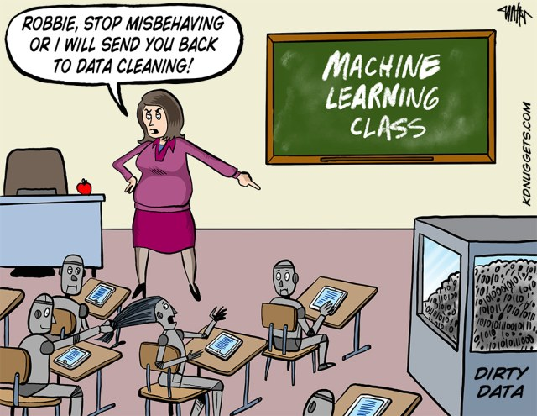
Notes:
Data cleaning

Slide 11
Machine learning at Edge Devices

Slide 12
ML computation moving from Cloud to Edge
the idea of distributing computing intelligence across an entire network instead of centralizing it in the cloud
in case of edge computing, you don’t need to send the data acquired by the IoT sensors anywhere. The device itself or the nearest network node (e.g. the router) is responsible for data processing and can respond in a proper manner if action is required.

Slide 13
Advantages of Edge Computing
Increasing data security and privacy
Better, more responsive and robust application performance
Reducing operational costs
Improving business efficiency and reliability
Unlimited scalability
Conserving network and computing resources
Reducing latency

Slide 14
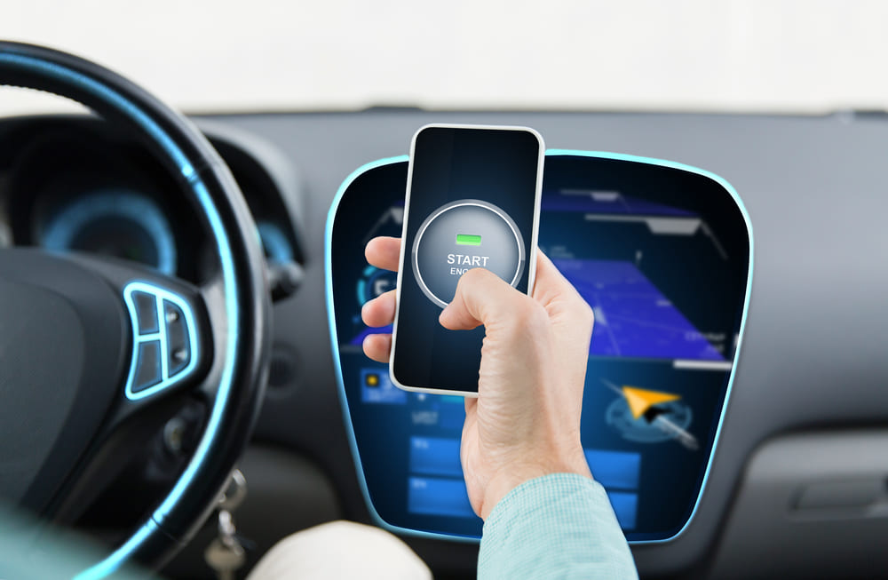
Use Case 1 – Autonomous Vehicles
Self-driving cars represent one of the important edge computing use cases.
A moving vehicle simply cannot rely on a remote server to decide if it needs to stop when there’s a pedestrian crossing the road in front of it.
The decision needs to be made immediately. The data has to be processed on the spot, regardless of the internet connection.
Plus, vehicles (while on the road) can communicate with each other more efficiently because they don’t need to send data about accidents, weather conditions, traffic or detours to the remote server first.

Slide 15

Use Case 2 – Health Care
One more practical case for edge computing lies within the domain of health monitors and other wearable devices. When used in telemedicine for keeping track of the patient’s chronic conditions, they can become real life-savers.
a heart rate monitor capable of analyzing health data independently, can instantly provide the necessary response to alert caregivers when a patient needs their help.
Robot-assisted surgery is another use case for edge computing in healthcare, especially when every nanosecond can mean the difference between life and death. These robots need to be able to analyze data on their own in order to provide assistance in surgery safely, quickly and accurately.

Slide 16
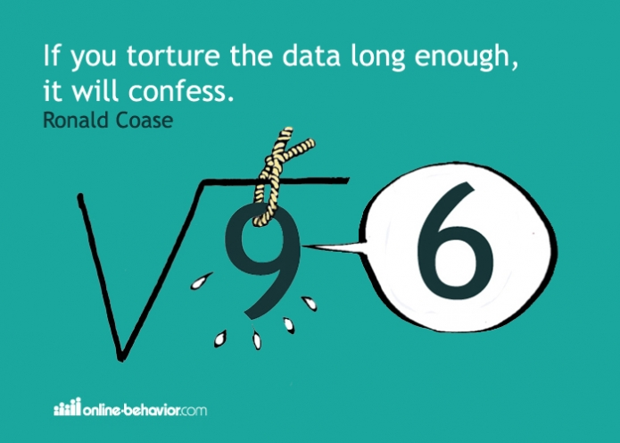

Slide 17
Popular ML frameworks for edge devices
Framework name | Edge device requirements
TensorFlow Lite – Google | Android, iOS, Linux, microcontrollers (ARM Cortex-M, ESP32)
ML Kit for Firebase – Google | Android, iOS
PyTorch Mobile – Facebook | Android, iOS
Core ML 3 – Apple | iOS
Embedded Learning Library (ELL) – Microsoft | Raspberry Pi, Arduino, micro:bit
Apache MXNet – Apache Software Foundation (ASF) | Linux, Raspberry Pi, NVIDIA Jetson
Notes:
TensorFlow Lite was developed by Google and has application programming interfaces [APIs] for many programming languages, including Java, C++, Python, Swift and Objective-C. It is optimized for on-device applications and provides an interpreter tuned for on-device ML. Custom models are converted in TensorFlow Lite format, and their size is optimized to increase efficiency.
ML for Firebase was also developed by Google. It targets mobile platforms and uses TensorFlow Lite, Google Cloud Vision API, and Android Neural Networks API to provide on-device ML features, such as facial detection, bar-code scanning, and object detection, among others.
PyTorch Mobile was developed by Facebook. The currently experimental release targets the two major mobile platforms and deploys on the mobile devices models that were trained and saved as torchscript models.
Core ML 3 comes from Apple and is the biggest update to Core ML since its original release, supporting several ML methods, especially related to deep neural networks.
ELL is a software library from Microsoft that deploys ML algorithms on small, single-board computers and has APIs for Python and C++. Models are compiled on a computer and then deployed and invoked on the edge devices.
Finally, Apache MXNet supports many programming languages (Python, Scala, R, Julia, C++, Clojure among others), where the python API offers most of the improvements on training models

Slide 18
Edge devices hardware specs
Edge device | GPU | CPU | ML software support
Coral SoM – Google | Vivante GC7000Lite | Quad ARM Cortex- A53 + Cortex-M4F | TensorFlow Lite, AutoML Vision Edge
Intel NCS2 | Movidius Myriad X VPU (not GPU) |  | TensorFlow, Caffe, OpenVINO toolkit
Raspberry Pi 4 | VideoCore VC6 | Quad ARM Cortex- A72 | TensorFlow, TensorFlow Lite
NVIDIA Jetson TX2 | NVIDIA Pascal | Dual Denver 2 64-bit + quad ARM A57 | TensorFlow, Caffe
RISC-V GAP8 |  |  | TensorFlow
ARM Ethos N-77 | 8 NPUs in cluster, 64 NPUs in mesh |  | TensorFlow, TensorFlow Lite, Caffe2, PyTorch, MXNet, ONNX
Notes:
Coral System-on-Module (SoM) by Google is a fully integrated system for ML applications that includes CPU, GPU, and Edge Tensor Processing Unit (TPU). The Edge TPU is an ASIC that accelerates execution of deep learning networks and is capable of performing 4 trillion operations (tera-operations) per second (TOPS).
The Intel Neural Compute Stick 2 (NCS2) looks like a standard USB thumb drive and is built on the latest Intel Movidius Myriad X Vision Processing Unit (VPU), which is a system-on-chip (SoC) system with a dedicated Neural Compute Engine for accelerating deep-learning inferences.
Raspberry Pi 4 is a single-board computer based on the Broadcom BCM2711 SoC, running its own version of the Debian OS (Raspbian); ML algorithms can be accelerated if the Coral USB is connected to its USB 3.0 port.
NVIDIA Jetson TX2 is an embedded SoC used for deploying computer vision and deep learning algorithms. The company also offers the Jetson Xavier NX.
RISC-V GAP8 is designed by Greenwaves Technologies and is an ultra-low power, eight-core, RISC-V based processor optimized to execute algorithms used for image and audio recognition. Models have to be ported to TensorFLow via the Open Neural Network Exchange (ONNX) open format before deployed.
ARM Ethos N-77 is a multi-core Neural Processing Unit (NPU), part of the ARM Ethos, ML-focused family. It delivers up to 4 TOPs of performance and supports several ML algorithms used for image/speech/sound recognition.
ECM3531 is an ASIC by Eta Compute, based on the ARM Cortex-M3 architecture which is able to perform deep learning algorithms in very few milliwatts. Programmers can choose to run deep neural networks on the DSP, which reduces the power consumption even more.

Slide 19
Conclusions
Due to the limited memory and computation resources of edge devices, training large amounts of data on the devices is not feasible most of the times. The deep learning models are trained in powerful on-premises or cloud server instances and then deployed on the edge devices.
Developers can use several methods to tackle this issue: designing power-efficient ML algorithms, developing better and more specialized hardware, and inventing new distributed-learning algorithms where all IoT devices communicate and share data.
The last approach is limited by the network bandwidth, therefore future 5G networks, which provide ultra-reliable, low-latency communication services, will help immensely in the area of edge computing.
Notes:
There’s no doubt that Machine Learning and Artificial Intelligence will make the Edge more intelligent and pave the way for next-gen solutions. AI in the edge is attracting developers and researchers to test their new ideas, develop models, customize them and reap benefits of AI in their work.

Slide 20
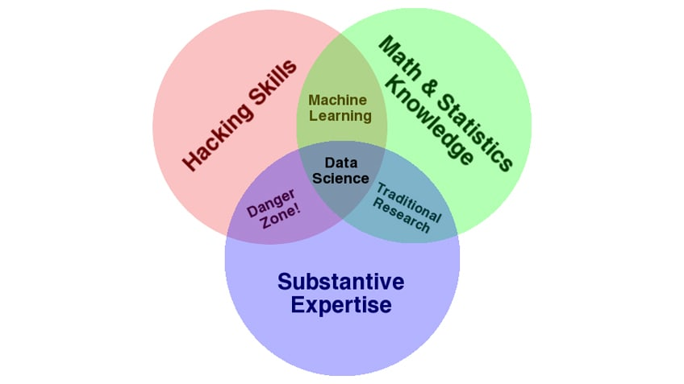
Roles in Machine Learning Team
The team should have the right resourcing level with right skill sets and in the right proportions:
Domain Expert
Data Architect
SW Coding Expert
Machine Learning Expert (this is an essentially mathematical skill)
Visualization Expert
Each of these is an engineering discipline in it’s own right.
They cannot be replaced by tools. For example, a machine learning expert cannot be replaced by a machine learning tool such as TensorFlow. The Viz expert cannot be replaced by a “visualization tool.”
Source: Drew Conway

Slide 21
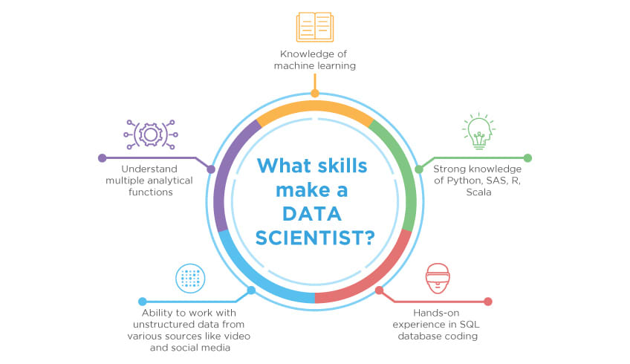
What Skills make Data Scientist

Slide 22

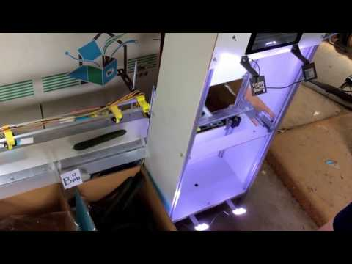
Tensor Flow Cucumber sorter
https://youtu.be/4HCE1P-m1l8

Slide 23


